Slide 1
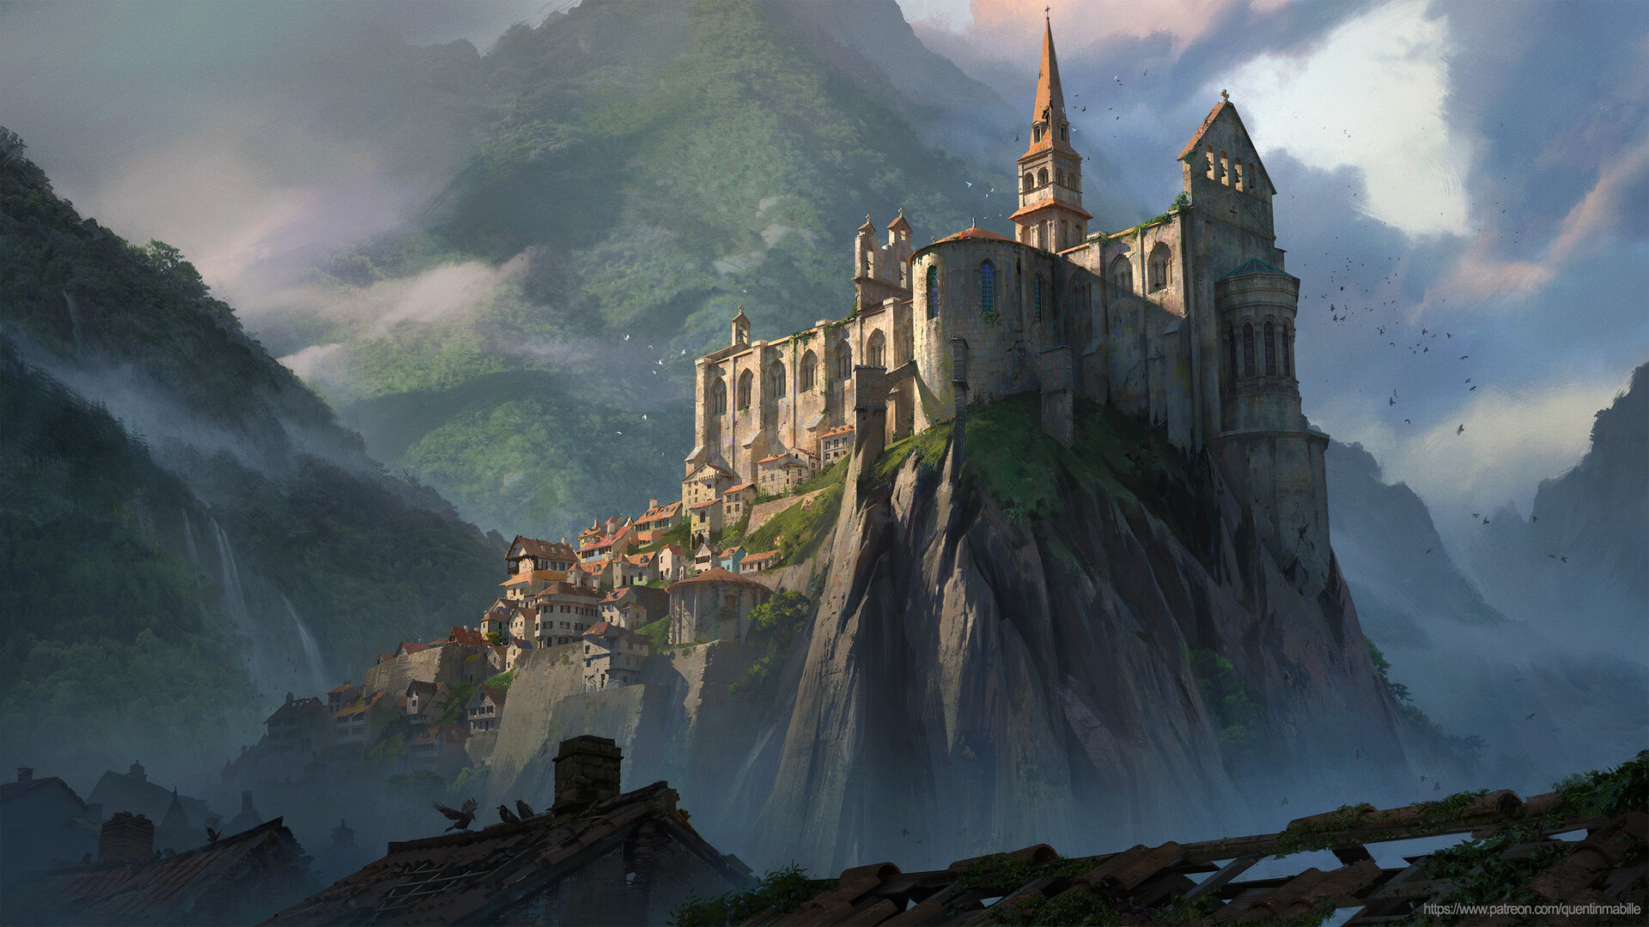

The Vengeance
Diogo Escoval
Sofia Ferreira
Nuno Teixeira

Slide 2
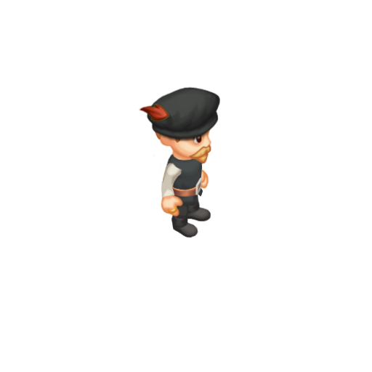
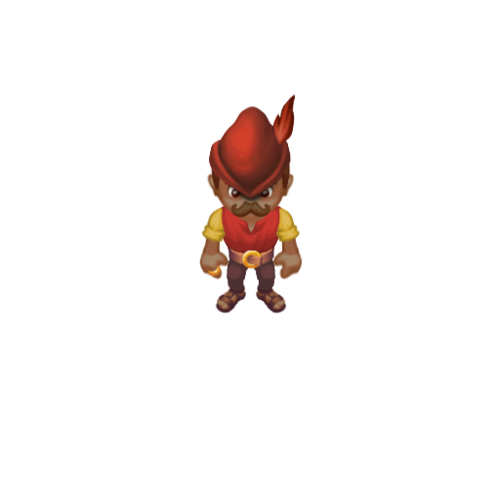
Game Concept
2D Action-Adventure
Medieval Fantasy
Top-Down View
Single-Player
Windows

Slide 3
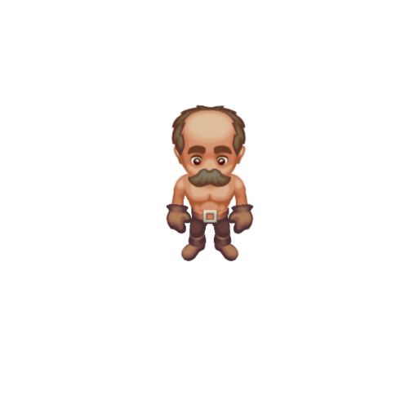
Setting
Explore
Quests
Fight
Get Revenge

Slide 4
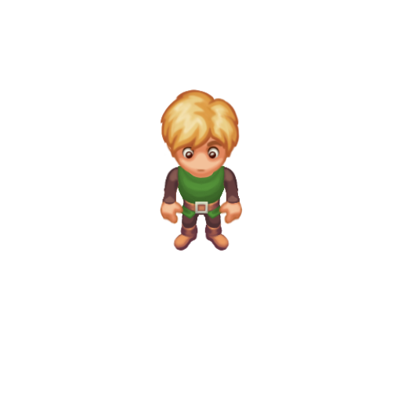

Player Actions
Movement
Basic Attack
Strong Attack
Shield

Slide 5
Enemies
Orc
Skeleton
Golem

Slide 6
Game

Slide 7
Companion App

Slide 8
Thank you for your
attention

